Slide 1



LAPTOPSHOP
PRESENTATION

Slide 2

LIST OF CONTENT
PRESENTATION
HOME PAGE
USER REGISTER
LOGIN
BLOG LIST
BLOG DETAILS
PRODUCT LIST
PRODUCT DETAILS
CART DETAILS
CART CONTACT
CART COMPLETION
MY ORDERS
ORDER INFORMATION
FEEDBACK
14. SALE DASHBOARD
15. ORDER LIST
16. ORDER DETAILS
17. USER AUTHORIZATION

Slide 3

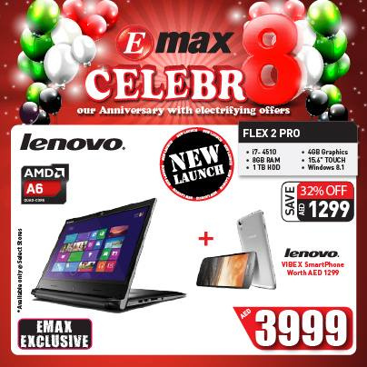
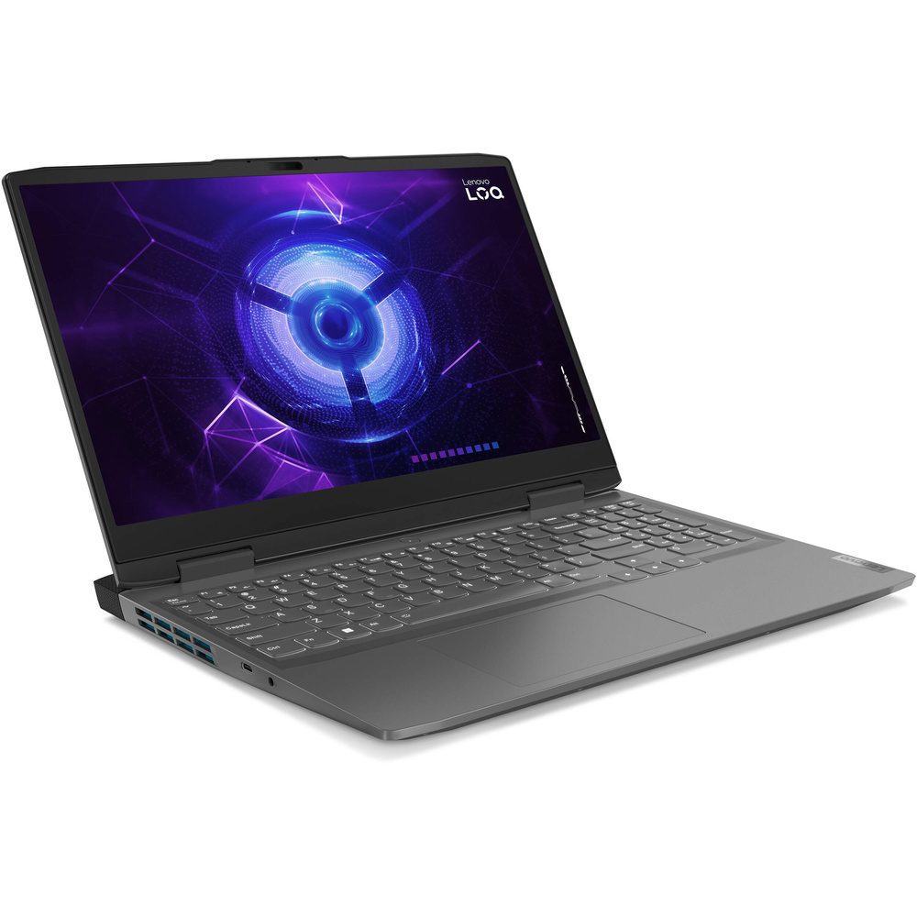

HOME PAGE
FEATURED LAPTOP
EVENTS
LETS GET STARTED
HOT BLOGS/ LATEST BLOG

Slide 4
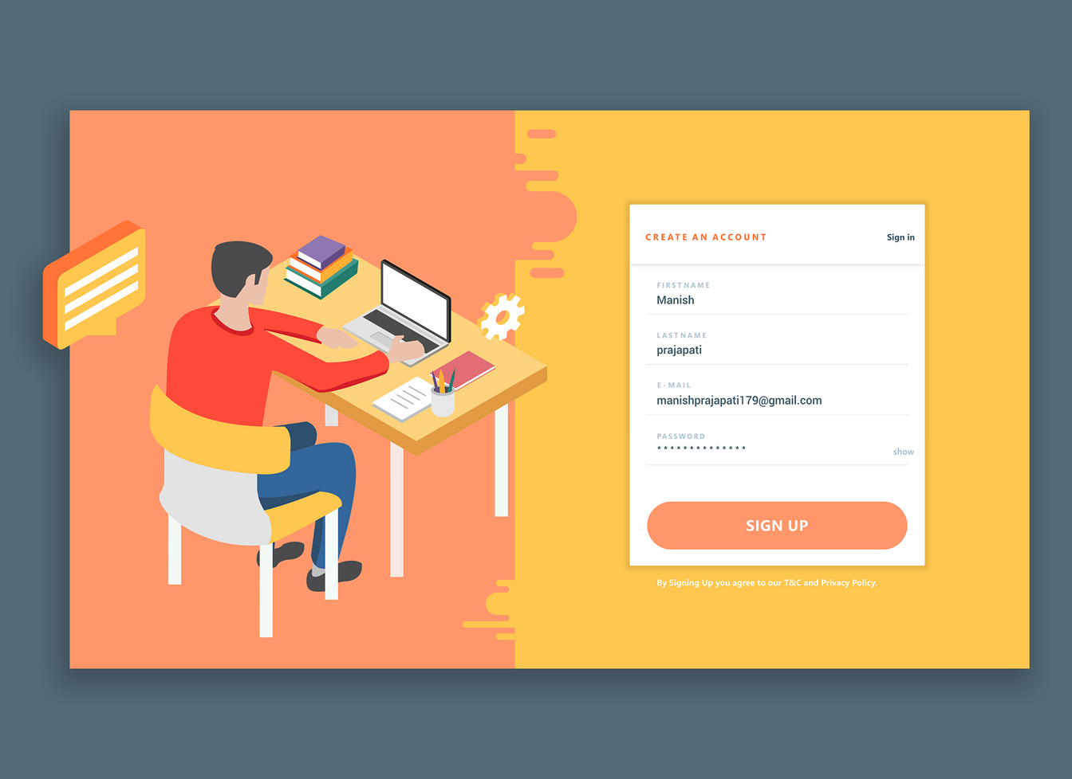
REGISTER
FULLNAME
EMAIL
PHONE
GENDER
ADDRESS
PASSWORD
RE-ENTER PASSWORD

Slide 5

LOGIN
USER EMAIL
PASSWORD
IS ACTIVATED ?

Slide 6


BLOG LIST
Review
Event

Slide 7



BLOG DETAILS
POST
Content
title

Slide 8


PRODUCT LIST
PRODUCT
price

Slide 9
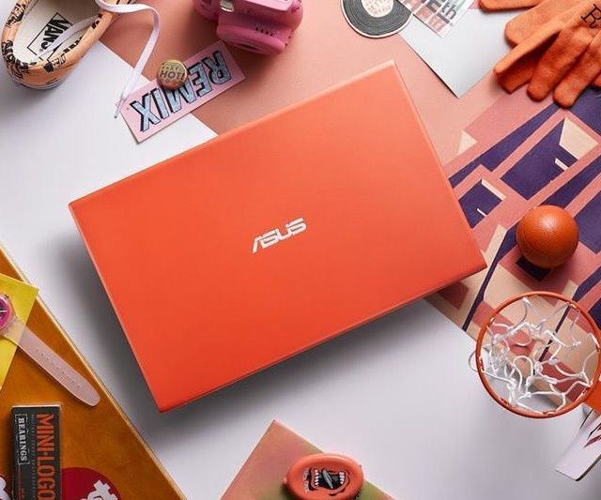


PRODUCT DETAIL
NAME PRODUCT
price
SIDER

Slide 10

CART DETAILS
PRODUCT
QUANTITY

Slide 11

CART CONTACT
PRODUCT
QUANTITY
ORDER USER INFORMATIONS:
NAME
ADDRESS
EMAIL
GENDER

Slide 12

CART COMPLETION
PRODUCT
QUANTITY
TOTAL PRICES
ORDER USER INFORMATIONS:
NAME
ADDRESS
EMAIL
GENDER
PAYMENT STATES:

Slide 13

MY ORDER
PRODUCT(S)
PRICES
ORDER ID
STATES

Slide 14
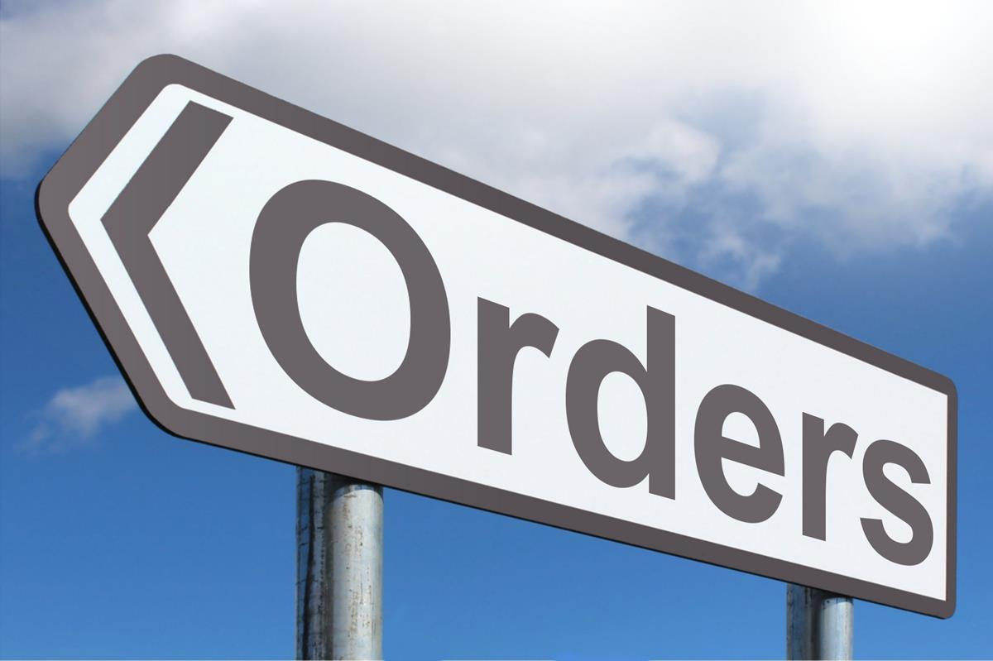
ORDER INFORMATION
PRODUCT
QUANTITY
ORDER ID
STATES
USER INFORMATION

Slide 15

FEEDBACK

Slide 16


Succes order
Revenue

Slide 17

ORDER LIST
Information order
id
order date
customer name
product
.....

Slide 18



ORDER DETAILS
ORDER INFORMATION
receiver information
list of ordered products

Slide 19
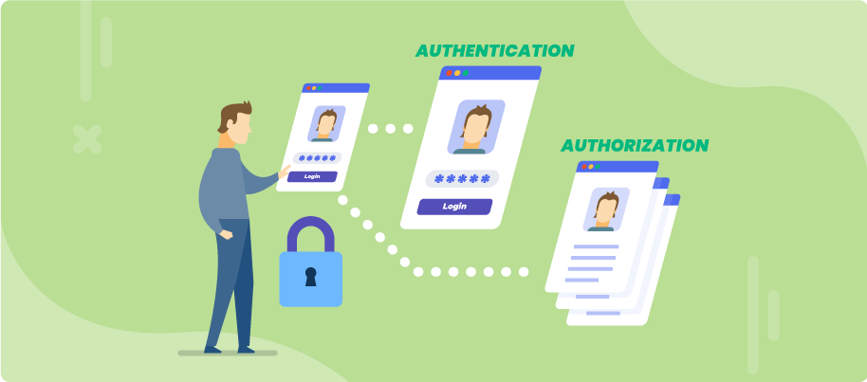
USER AUTHORIZATIONS
URL(S)
CURRENT USER ROLE

Slide 20

THANKS FOR
LISTENING

